Slide 1
PROJECT TEAM MEMBERS
PRAKASH 19csu214
MOHIT 19csu179
MANISH 19csu173
DHRUV MEHTA 19csu091

Slide 2
BLOOD BANK MANAGEMENT SYSTEM

Slide 3
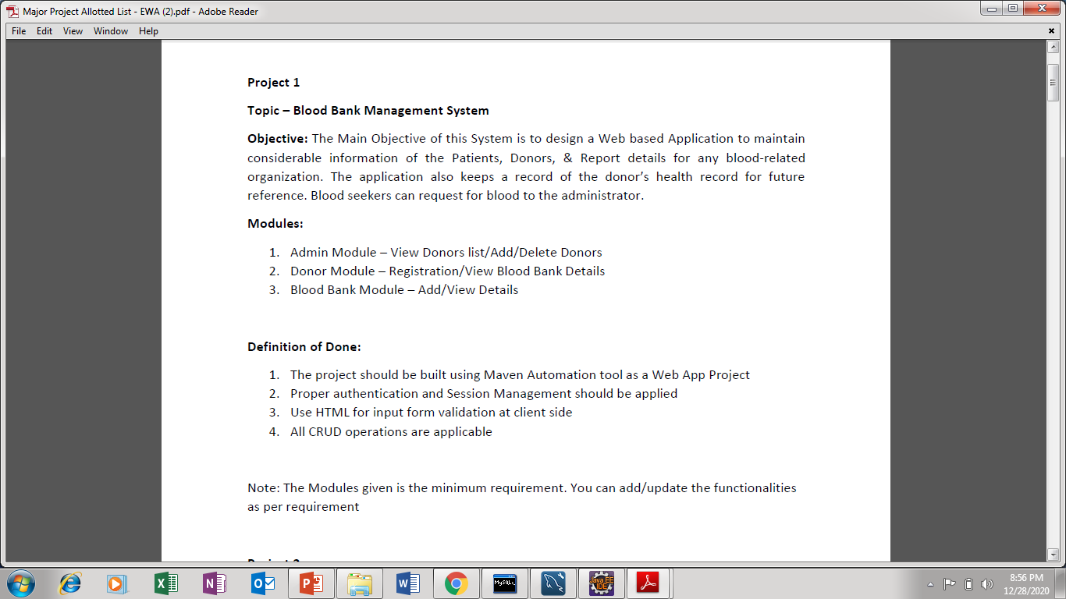

Slide 4
INTRODUCTION
The project Blood Bank Management System facilitates an organization to manage the details of blood related information , donor info, blood request, using basic CRUD operations. This system is designed to reduce the workload of Administrative Department.
It has different modules like :
Admin Login
Request For Blood
Add New Donor Or Delete/Update Existing Donor
Stock Management Of Blood

Slide 5
OBJECTIVE
Every blood bank organization has to perform certain functions such as blood request , maintaining records of blood donors , etc.
The main objective of this project is to automate the functionalities of the Administrative Department for efficient working of these tasks.

Slide 6
TECHNOLOGY DESCRIPTION
Java Server Pages
Java Server Pages(JSP) is a java technology used for developing web pages that supports dynamic content which helps developers to insert java code in HTML pages by making use of special JSP tags, such as scriplets, JSTL etc.
These tags can be used for a variety of purposes, such as retrieving information from a database or registering user preferences, passing control between pages and a lot more.

Slide 7
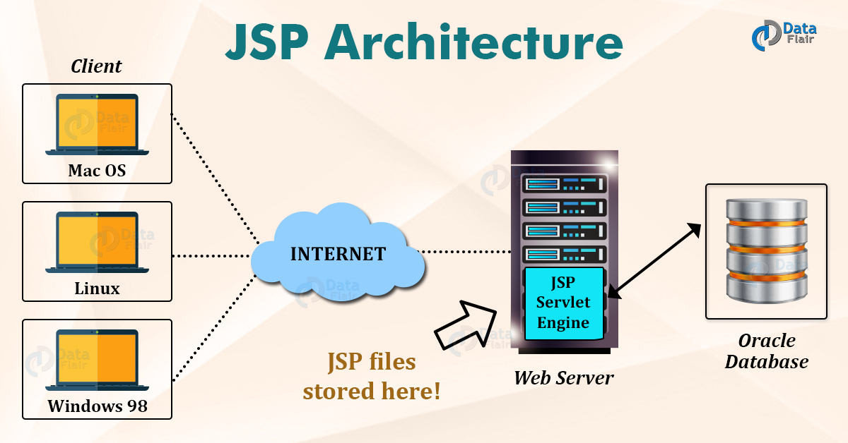
JSP ARCHITECTURE

Slide 8
SOFTWARE SPECIFICATIONS
Software Platform : Eclipse (for EE Developers)
Environment : Apache Tomcat Webserver 9.0 & above Software
Front End : HTML/CSS
Back End : Servlets/JSP/JDBC and MySQL database

Slide 9
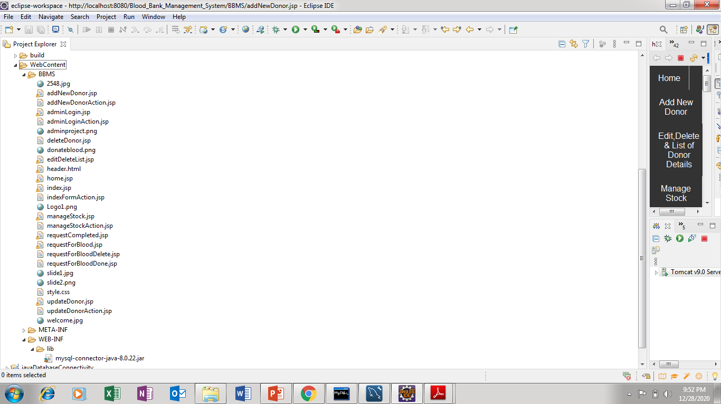
PROJECT FOLDER LAYOUT

Slide 10
METHODOLOGY
Login Module :
Security mechanism to provide user authentication
Ensures only authenticated and authorized users (Admin in this case) can access the links and navigation paths to perform operations such as adding/updating details.
The entire project is developed using Dynamic Web Project
All modules consist of JSP Pages, Servlet class, various Java classes
Java classes are used to handle the basic business logic for holding data in Java class objects
Java Classes → communicates with the database (MySQL)
JSP/HTML/CSS pages
Servlet Class → takes the request from client side & perform business logic through Java class objects and sends the response back the client

Slide 11
COMPILE AND RUN SCREENSHOTS

Slide 12
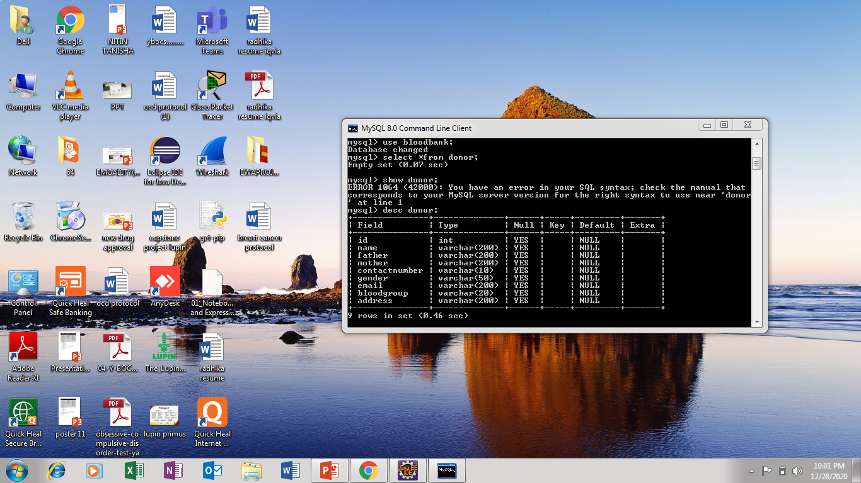
BACKEND DATABASE MYSQL

Slide 13
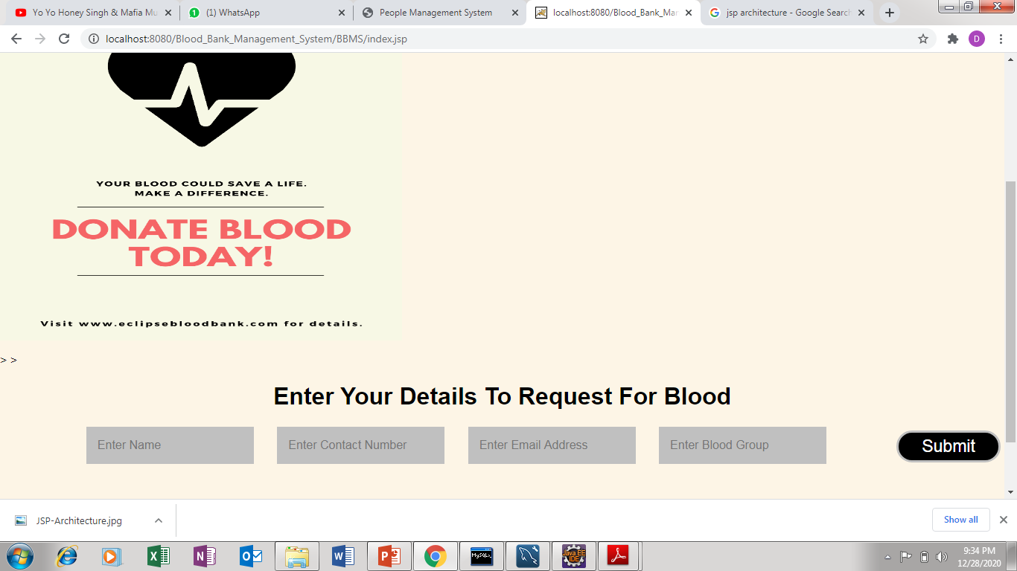
HOME PAGE

Slide 14
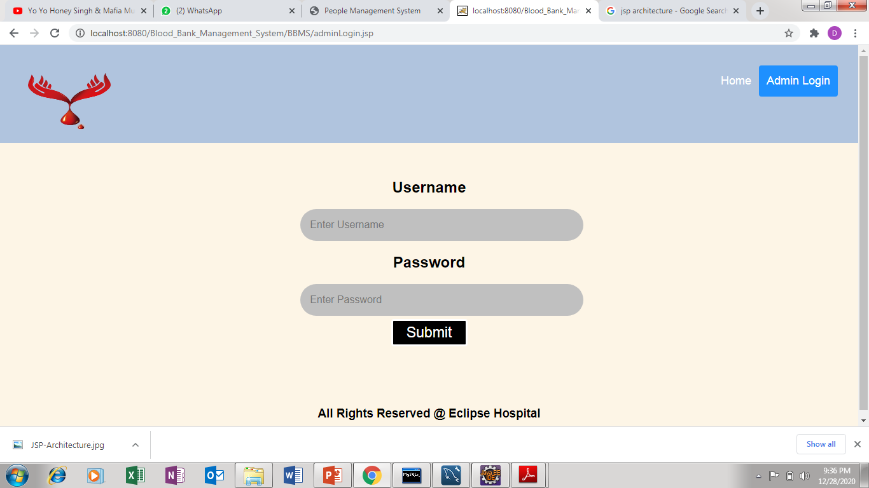
ADMIN LOGIN

Slide 15
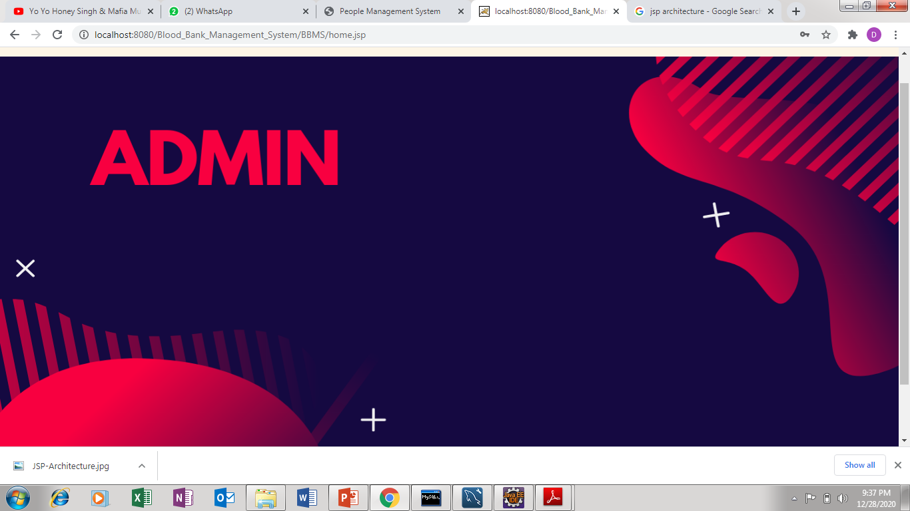
ADMIN LOGIN HOME PAGE

Slide 16
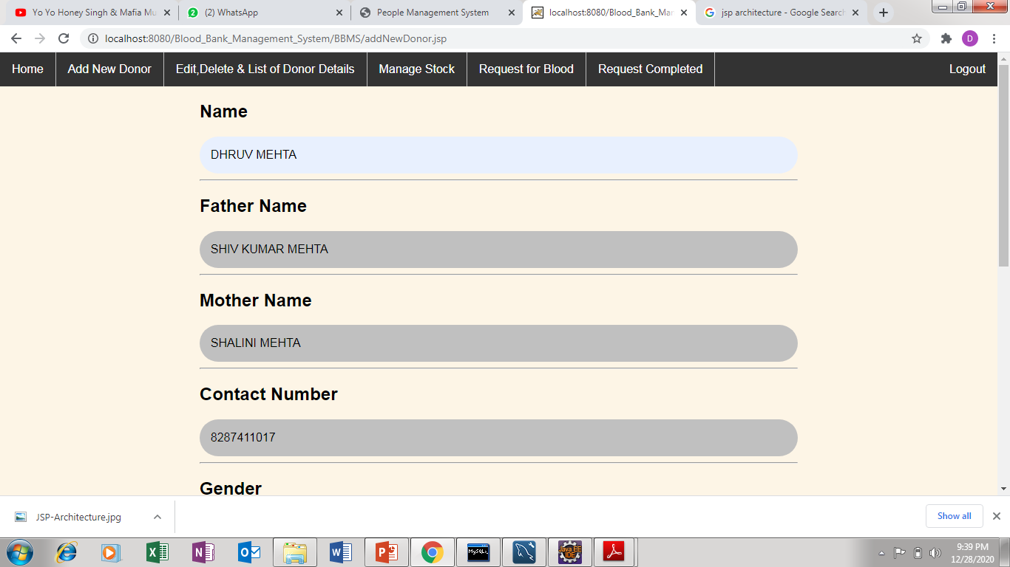
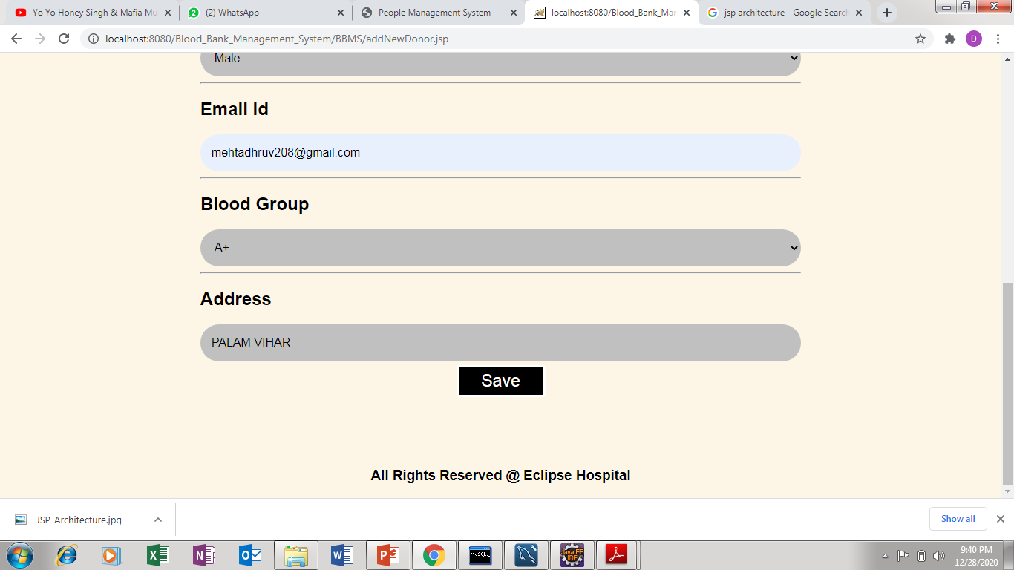
ADD NEW DONOR

Slide 17
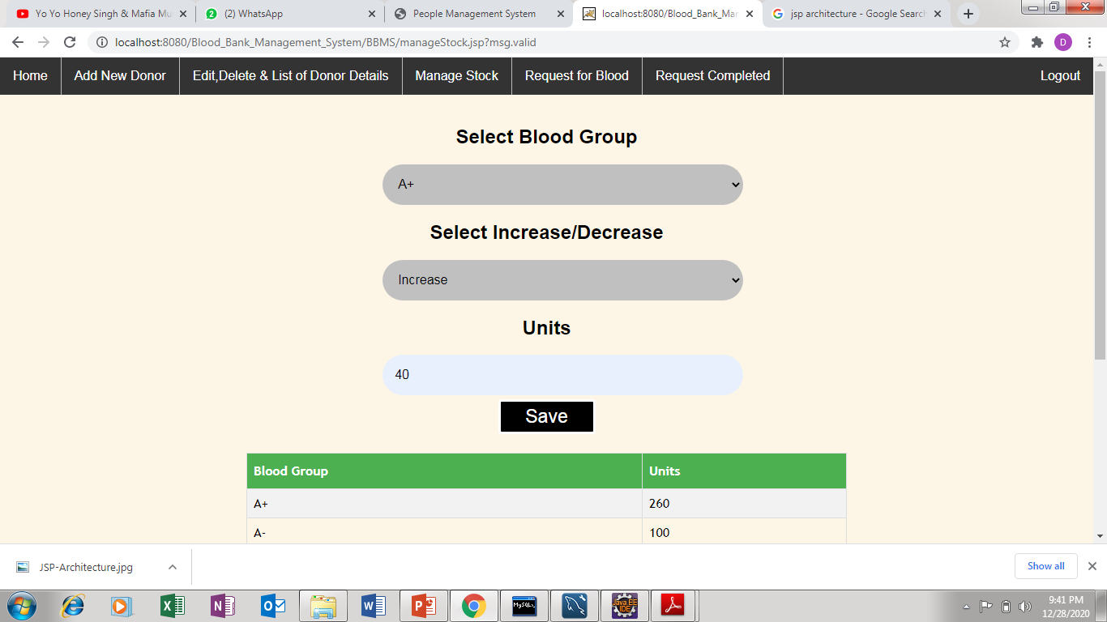
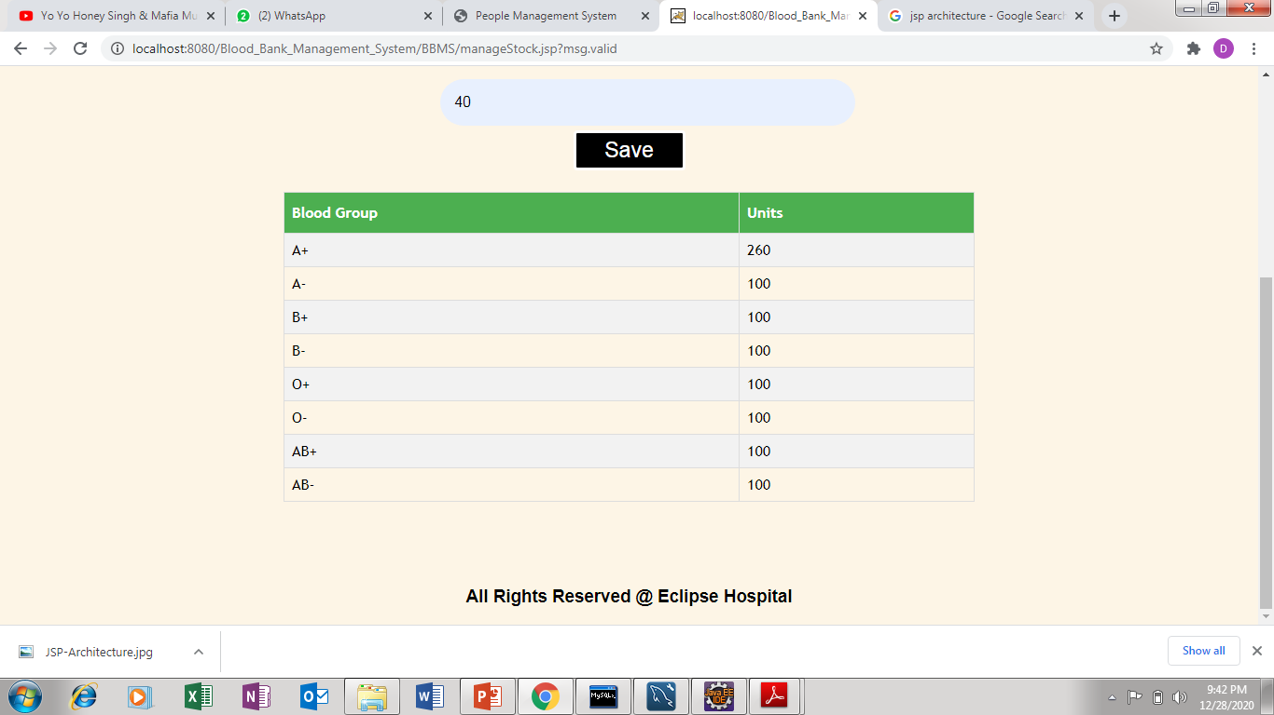
BLOOD STOCK MANAGMENT

Slide 18
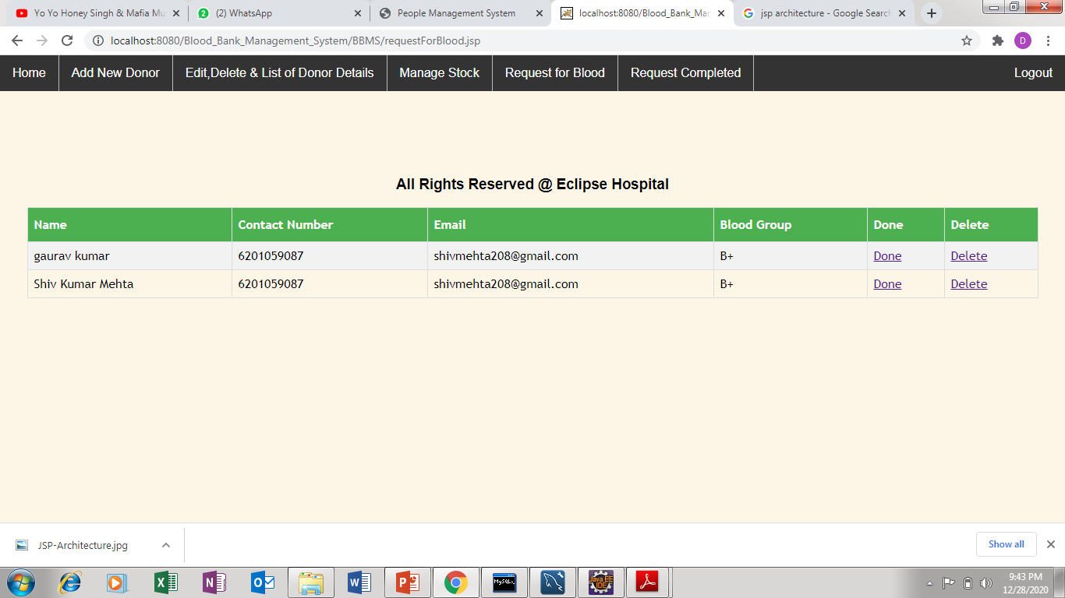
REQUEST FOR BLOOD

Slide 19
ACKNOWLEDGMENT
We would like to express our special thanks of gratitude to our subject teacher “Mr. Sumit Kumar” for their able guidance and support in completing our Project.
We would also like to extend our gratitude to The NorthCap University for providing us the opportunity to display the Project in presence of the ACCENTURE Company Specialist and also like to extend our gratitude towards the Externals for providing their valuable time to analyze and guide us through the project.

